Slide 1

PREDICTING CUSTOMER BUYING FEATURES
August 2023

Slide 2
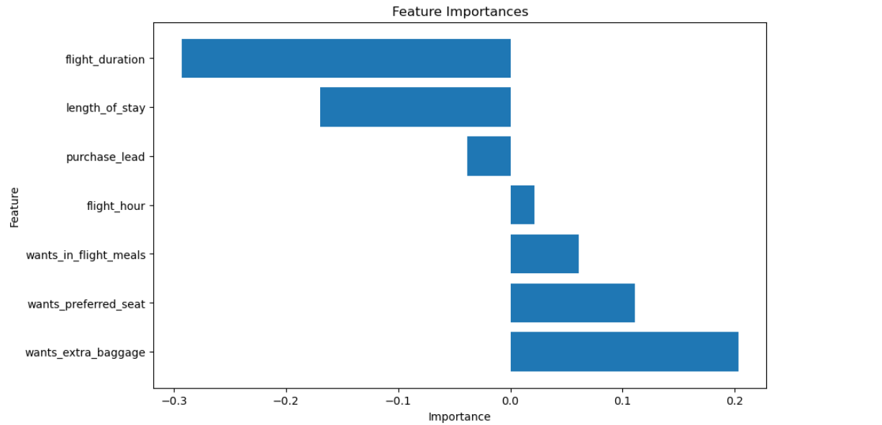
Data Overview
The dataset comprises customer booking information, encompassing various attributes related to flight bookings.
The target variable, "booking complete," indicates whether a booking was successfully completed.
Methodology
Linear Regression Model, XG Boost Classifier
Key takeaways
The XGBoost model attains an accuracy of 0.8512, which is 85%.
Features positively correlated with booking completion - Extra baggage, preferred seat, in-flight meals and flight hour.
Features negatively correlated with booking purchase - Purchase lead, length of stay and flight duration.

